Slide 1

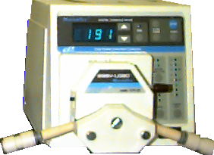
Effluent
Downflow through Carbon Column
Red dye #40
Distilled water
Emergency
Valve
Drain
T
-
connector

Slide 2

Effluent
Downflow through Carbon Column
Red dye #40
Distilled water
Emergency
Valve
Drain
T
-
connector

